Slide 1
跟着Kevin学英语(5)
认识字母表
P S B D F C L

Slide 2

P p
Playgroup
Notes:
They are going to the playgroup

Slide 3
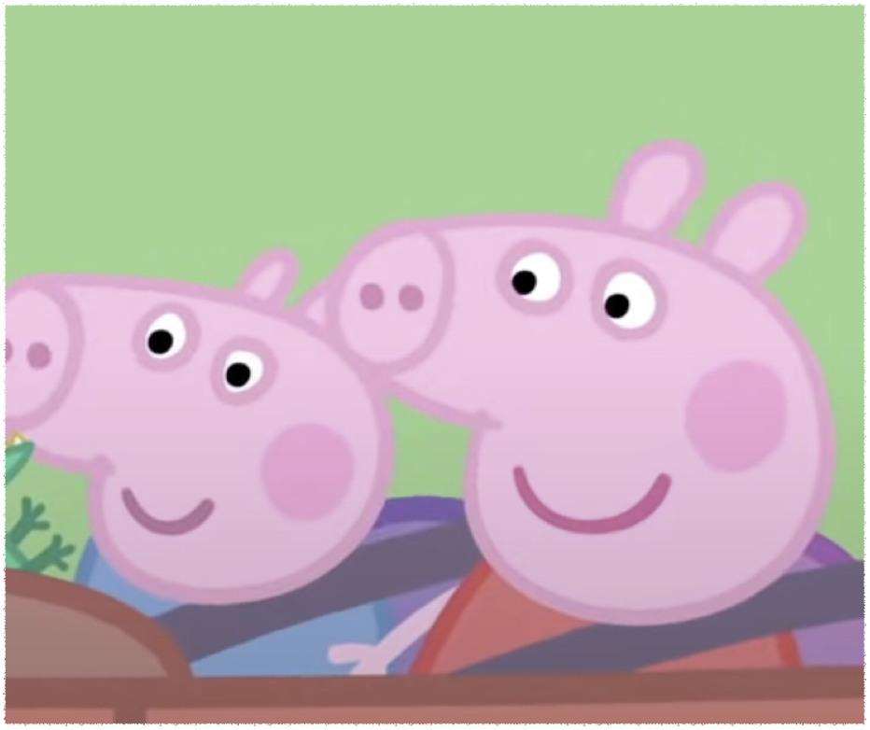
S s
Small
Notes:
George is too small

Slide 4
B b
Big
Brilliant
Notes:
Peppa is big

Slide 5
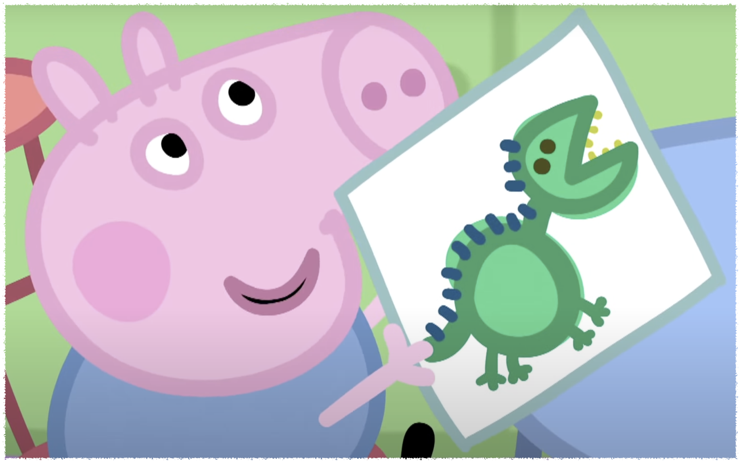
B b
Big
Brilliant
Notes:
He is brilliant

Slide 6
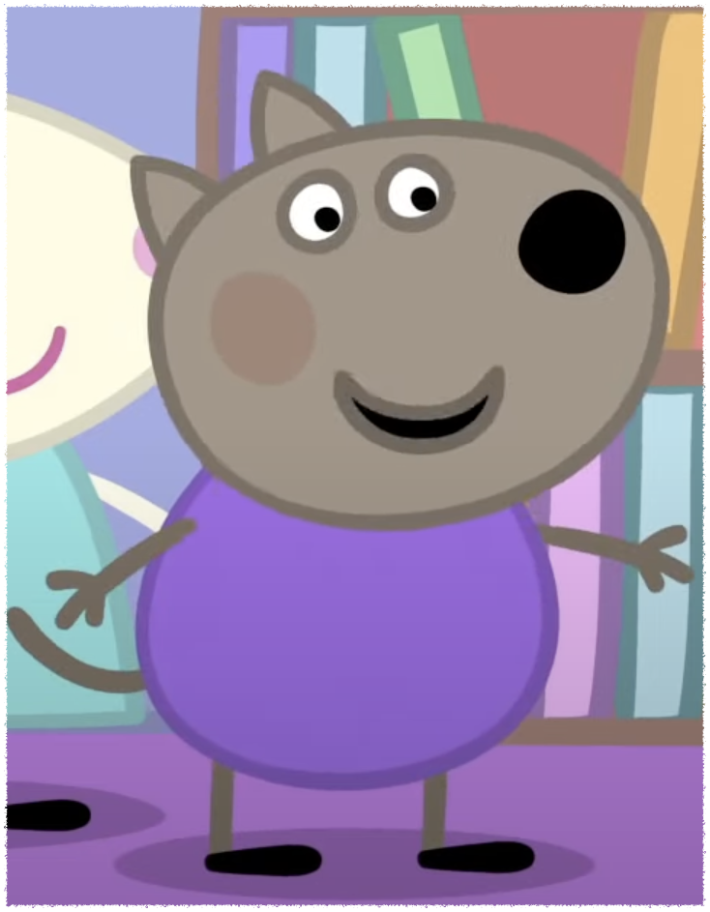
D d
Dog
Notes:
He is a dog

Slide 7

P p
Paint
Petal
Notes:
I can paint a flower

Slide 8

P p
Paint
Petal
Notes:
Flowers have petals

Slide 9

F f
Flower
Notes:
This flower has two leaves

Slide 10

C c
Circle
Color
Notes:
You paint a big circle

Slide 11

C c
Circle
Color
Notes:
It’s different colors

Slide 12

L l
Leaf
Notes:
The leaves are green

Slide 13
He will be fine
Im very brilliant
Im very good
You can help him

